Slide 1
Computer Vision with Embedded Machine Learning
Transfer Learning and MobileNet

Slide 2
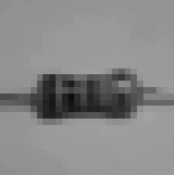
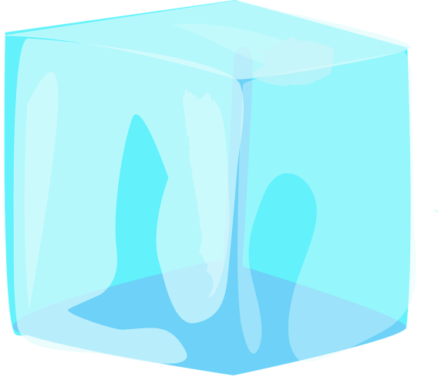
Transfer Learning
Input (2D array)
2D Convolution
2D Max Pooling
Feature extraction
2D Convolution
2D Max Pooling
Flatten to Vector
Classifier (DNN)
Softmax
P₁
P₂
P₃

Slide 3
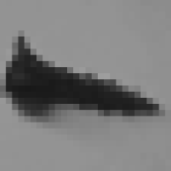
Transfer Learning
Input (2D array)
2D Convolution
2D Max Pooling
Feature extraction (frozen)
2D Convolution
2D Max Pooling
Flatten to Vector
New Classifier (DNN)
Softmax
P₁
P₂
P₃
P₄

Slide 4
Fine-Tuning
Input (2D array)
2D Convolution
2D Max Pooling
Feature extraction
2D Convolution
2D Max Pooling
Flatten to Vector
New Classifier (DNN)
Softmax
P₁
P₂
P₃
P₄

Slide 5
Why do transfer learning?
Faster
Smaller training dataset

Slide 6
2D Convolution
2D Max Pooling
2D Convolution
2D Max Pooling
Flatten to Vector
Softmax
P₁
P₂
P₃
P₄

Slide 7
P₄
P₃
P₂
P₁
Softmax
Flatten to Vector
2D Max Pooling
2D Convolution
2D Max Pooling
2D Convolution

